Slide 1



Embracing Evolution Together
Navigating Organizational Transitions
Famous 5 Consulting
Devina, Hui Hui, Kieman, Kruti, Nann, Xueting

Slide 2


We aspire as ONE.
Connecting people with diverse expertise in delivering futuristic solutions
where innovative technology empowers businesses.
1
2
3
4
Managing Stakeholders’ Expectations and Needs
Communication Strategy for Change
Employee Training and Development Programme
Sustaining Organisational Change
Moving as one requires alignment to have a common understanding.
Effective communication is key in managing change successfully in organizations.
Providing training opportunities ensures employees are equipped to handle changes effectively.
Involving employees in the change process leads to greater acceptance and commitment.

Slide 3











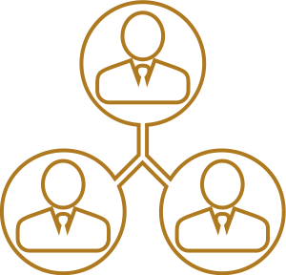

Vision for Change
Goal
Operational
Excellence
Customer
Intimacy
Improved Data Visibility &
Decision-Making
Product
Leadership
Implement automation solutions across all internal operations, aiming for a 30% increase in efficiency within the next two years.
Improve customer satisfaction by 15% through personalized digital engagement initiatives and streamlined customer service processes within the next year – Digitize Strategic Accounts Programme.
Enhance internal digital integration by implementing an integrated Enterprise Resource Planning (ERP) system, achieving 90% system adoption within the next six months.
Develop and launch three new innovative automation products tailored to specific B2B market needs within the next 18 months.
Objectives
Key Drivers
Honeywell Digital
Team
Strategic Team
Supply Chain
Transformation
Team
Honeywell Digital
Team
Supply Chain
Transformation
Team
Honeywell Digital
Team
Honeywell Digital
Team
Strategic Team
Four Strategic Business Groups (SBGs)
Notes:
Goal:
Operational Excellence:
Customer Intimacy:
Improved Data Visibility:
Product Leadership:

Slide 4

Case for Change
Problems
Opportunities
Cultural Gap challenges and the failure to focus on innovation.
Prioritizing short-term goals and investor pressures.
Challenges in integrating digital solutions and a connected ecosystem through HCE to deliver software solutions.
Missed opportunities for revenue growth, operational efficiency, innovation, and competitive advantage, ultimately impacting Honeywell's long-term success and sustainability.
If we do nothing...
Impact to Organization
Cost & Risks
Technological Adaption:
Continuous Updates require significant investment in resources.
Failure to adapt poses threats including falling behind competitors and cybersecurity risks.
Market Dynamics:
Continuous strategy adjustments to meet market preferences may incur costs for research, development, and resource allocation.
Loss of relevance, decreased satisfaction, and reduced competitiveness.
CURRENT
ANTICIPATED
Challenges
Outcome
Technological Adaptation: Continuous updates are needed despite successful digital integration through HCE for sustained competitiveness.
Market Dynamics: Evolving preferences demand continuous strategy adjustments for sustained competitiveness.
Improved competitiveness, market relevance, operational efficiency, and sustainable growth for Honeywell
If we do something...

Slide 5






Proposed Change
Current State
Desired
Outcomes
Greater profitability
Sustainable long-term growth.
Are we innovative?
Diminished reputation and brand value as a conservative and inflexible organization resulting in lesser profitability and unsustainable long-term growth.
Change Required
Increased agility and responsiveness to market demands and emerging technologies.
Enhanced reputation and brand value as a forward-thinking and adaptable organization.
ØIntegrate software and emerging technologies into core operations through team restructuring.
ØImplement a proactive communication plan to counter investor concerns.
ØBridge the cultural gap between Honeywell's "red" and "blue" sides. Foster a culture of innovation through incentive programs and innovation hubs.
Are we customer-focused?
Customer satisfaction and loyalty due to stagnant products and solutions.
Improved customer satisfaction and loyalty through innovative products and solutions.
Do we leverage on diversity?
Market adaptability and diminished employee morale due to a less inclusive work environment.
Enhanced employee morale and engagement resulting from a more inclusive and collaborative work environment

Slide 6
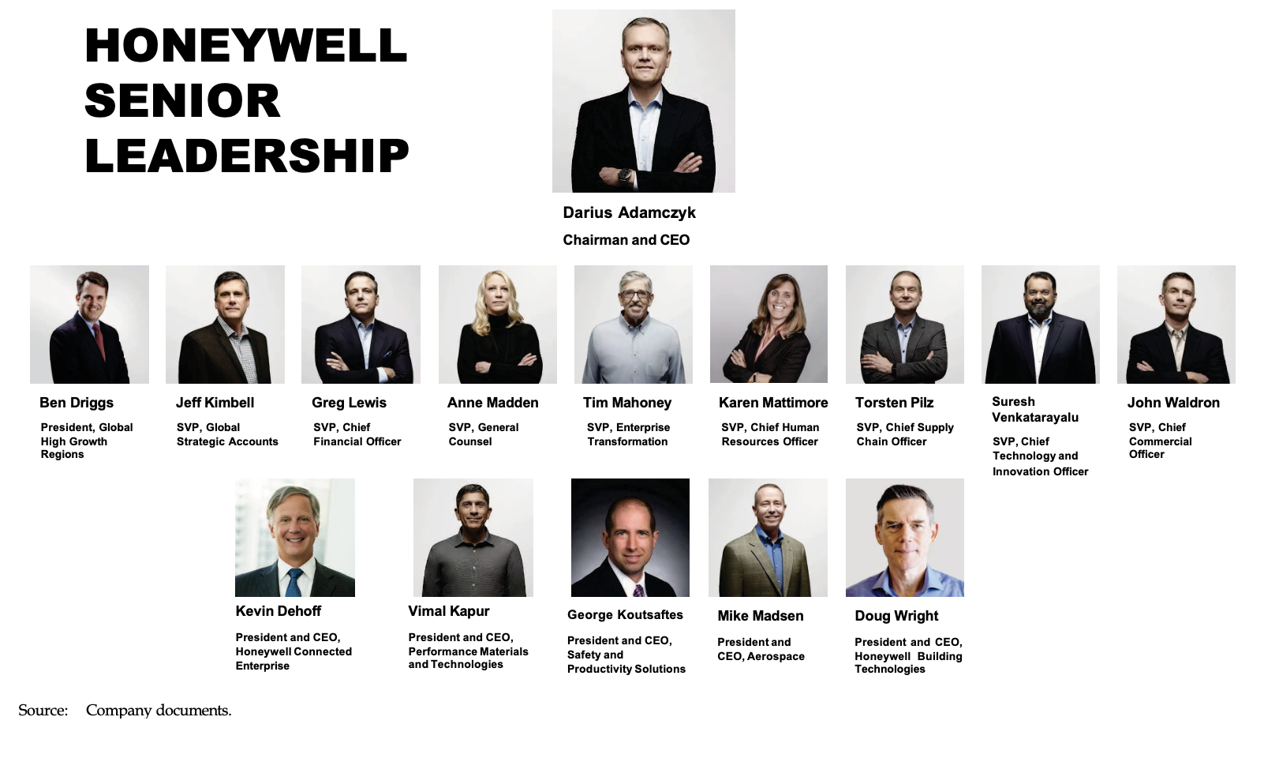
Reorganizing for Synergy
No Change to reporting lines of Organization Chart
Reorganized by teams for better synergies to become “One Honeywell”
Tim Mahoney (SVP, Enterprise Transformation)
Strategic Team
Honeywell Digital Team
Supply Change Transformation Team
Judy Kay (Chief Strategic Officer)
Jeff Kimbell
(Global Strategic Account)
Anne Madden (SVP, General Counsel)
Suresh Venkatarayalu (SVP, Chief Technology and Innovation Officer)
Kevin Dehoff
(President and CEO, HCE)
Vimal Kapur (President and CEO, PMT)
Torsten Pilz (SVP, Chief Supply Chain Officer)
John Waldron (SVP, Chief Commercial Officer)
Greg Lewis (SVP, Chief Financial Officer)
Gorge Koutsaftes (President and CEO, SPS)
Mike Madsen (President and CEO, AERO)
Doug Wright (President and CEO, HBT)
Notes:
Reorganizing for Synergy
Reorganized by teams for better synergies to become One Honeywell

Slide 7

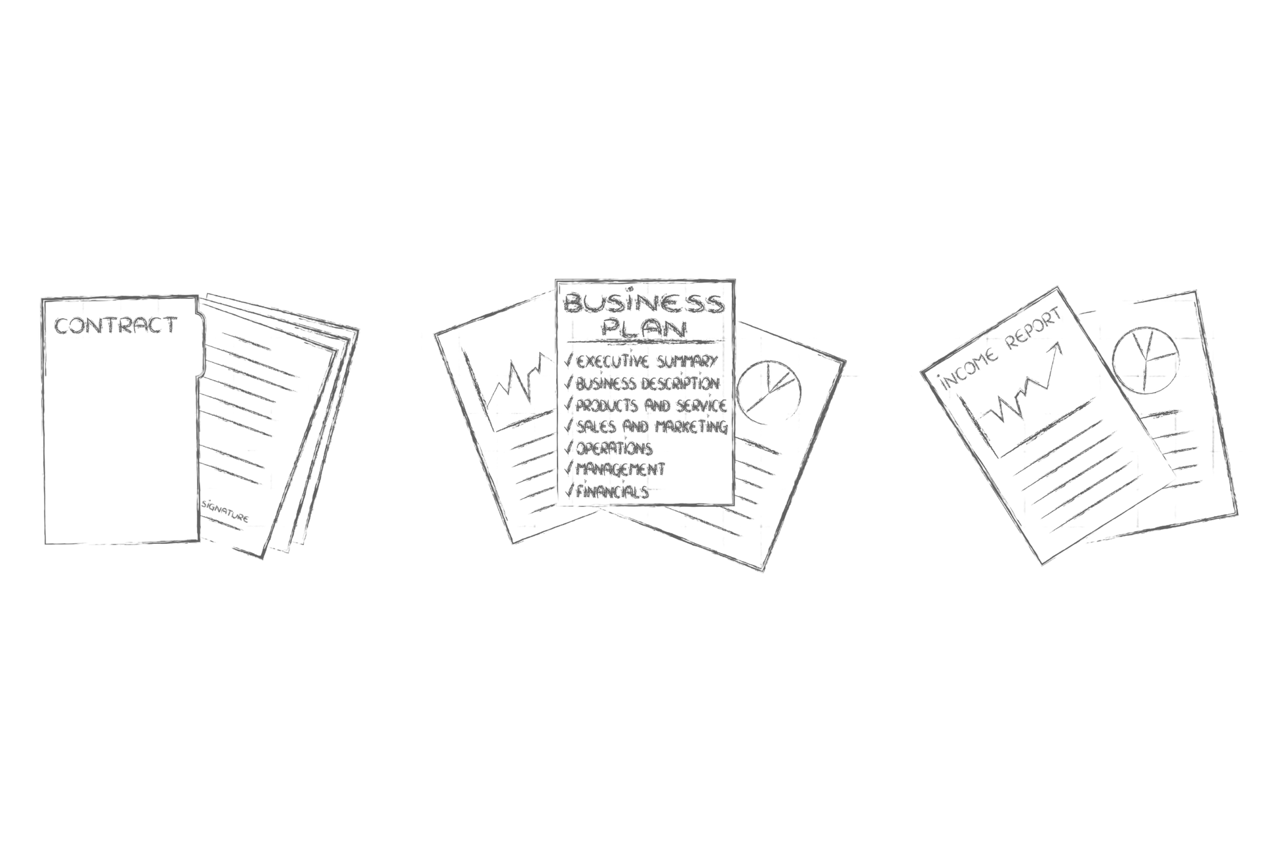
We move as ONE.
Stakeholder Management Plan

Slide 8
Stakeholder Mapping & Group Segmentation
Senior Management
Board of Directors
Performance Materials & Technologies
Government & Regulatory Bodies
Shareholders
& Investors
Honeywell Building Technologies
Middle Management
Local Community
Stakeholders
Safety & Productivity Solutions
Employees
Staff
Aerospace
NGOs
Customers
Honeywell Connected Enterprise
Suppliers & Partners
B2B
B2C

Slide 9
Stakeholder Needs & Concerns
Board of Directors
Employees
Financial Performance
Long-term Strategy & Direction
Career opportunities & development
Compensation & Benefits
Income stability
Shareholders & Investors
Customers
Profit sharing / Divident payouts
Returns on investment
Share prices
Needs & Concerns
Cost efficient products & solutions
Clear line of communication across SBGs
Solutions aligned to ESG goals
Suppliers & Partners
Local Community
Strong supply chain partnerships
Clear line of communication
Community support and engagement
Contribution to economic development & employment
Government & Regulatory Bodies
NGOs
Enviromental and corporate social responsbility
Human rights and inclusivity
Regulatory Compliance
Public Policy Advocacy

Slide 10
Stakeholder Analysis
High
Engage
Enlist their help as advocates
Government & Regulatory Bodies
Shareholders & Investors
Employees:
Defining stakeholder for successful change
Change needs to transcend hierarchy across 04 SBGs + HCE
Targeted approach for employees in each SBG
Board of Directors
NGOs
Ability to Change
Suppliers & Partners
Employees
Local Community
Customers
Engage and Train
Train
Room for Improvement
Motivation to Change
High

Slide 11

Anticipated Resistance to Change
Industry chemicals and manufacturing supplies, largely from AlliedSignal’s portfolio
Fire, Security, controls and automation products for buildings
Gas controls, safety-related sensors and switches, PPE
Avionics and other aircraft control equipment/services
Connected software business, connectivity solutions and cybersecurity
Cultural differences between “Red” and “Blue”
Created own Sustainable Technology Solutions with highest growth, less willing to change
Potential reliance on existing strategic accounts program to sell solutions – translated to lower priority amongst SBGs
Lower morale and ownership being least profitable SBG
75%/25% internal vs external hiring might mean propagating existing culture and morale does not improve
Strict regulatory compliance may stifle change
Perceived superiority as most profitable SBG
Tendency to be primary contact for strategic accounts program (top 100 customers by value)
Created profitable UAV standalone business unit without change – difficult to convince employees
Recent integration with Sparta QMS and cultural differences
Supports all 04 SBGs – struggles with different perspectives to fulfil similar function across company
Expansion to provide solutions as a business may impact internal servicing negatively as focus shifts
Performance Materials & Technologies
Honeywell Building Technologies
Safety & Productivity Solutions
Aerospace
Honeywell Connected Enterprise

Slide 12
Listening & Addressing Objections
Industry chemicals and manufacturing supplies, largely from AlliedSignal’s portfolio
Fire, Security, controls and automation products for buildings
Gas controls, safety-related sensors and switches, PPE
Avionics and other aircraft control equipment/services
Connected software business, connectivity solutions and cybersecurity
Align diversity, beliefs, values, norms and sense of belonging amongst all employees within PMT
Encourage continuous improvement beyond STS and cite success story to emulate performance
Promote successful stories of business development aside from leads from strategic accounts program
Highlight importance of SPS as a SBG to overarching business
Explore adjusting hiring policy specifically for SPS to inculcate new practices and culture
Leverage QMS to ensure regulatory compliance
Highlight importance of other SBGs in relation to AERO
Illustrate story of UAV to replicate success
Recent integration with Sparta QMS
Highlight HCE’s ability to operate as standalone, profitable business unit
Recruitment and job redesign to ensure sufficient support to company and operate profitably
Performance Materials & Technologies
Honeywell Building Technologies
Safety & Productivity Solutions
Aerospace
Honeywell Connected Enterprise

Slide 13
What’s in it for me?
Business Unit | Business priorities / Interests | Potential Outcomes and Benefits
Performance Materials & Technologies | Address divide between “Red” & “Blue”, thereby improving business performance | Healthier working relationships and workplace culture Lower attrition
Honeywell Building Technologies | Reduce reliance on leads from strategic accounts program and promote business development | Improved customer focus and satisfaction resulting in greater confidence in products and repeat sales Lower reliance on strategic accounts program and promote ownership within SBG
Safety & Productivity Solutions | Increased recognition within Honeywell and ownership within employees | Establish diverse workforce to generate new ideas and leads, uncover blind spots Increased job satisfaction
Aerospace | Concerns of displacement as most profitable SBG and perceived importance | Improved customer intimacy resulting in new clients Increased sales to existing clients with innovative solutions Extended “lead” in Honeywell’s portfolio of products
Honeywell Connected Enterprise | Concerns over lack of resources to service internal SBGs while embarking on business development | Improved data visibility and decision making through: Increased oversight across all SBGs with added manpower and diversity Added focus on providing solutions to clients directly and increase sales

Slide 14
Target the “chiefs”, win them over
Chief Strategy Officer
Judy Kay
SVP, Chief Technology and Innovation Officer
Suresh Venkatarayalu
SVP,
Chief Supply Chain Officer
Torsten Pilz
Appeal to “customer-centric” approach
Achieve co-innovate, co-develop, co-fund with higher success rates
Appeal to “R&D” interests in Honeywell
Achieve greater NPIs with better internal controls
Appeal to “operational efficiency” internally
Achieve quicker delivery of solutions provided to clients

Slide 15

Change Sponsor
Coalition building
Active and Visible Participation
Communication of business messages about change
Tim Mahoney
Lobby for resources with senior management
Open to new ideas and adopt open-door policy to questions
Leads and provide guidance to change
Lends strong support to encourage employees leading change and build camaraderie
Highlight importance and success stories tailored to respective SBGs and hierarchy
Reiterate importance of change and purpose

Slide 16

We connect as ONE.
Keep involved
Keep informed
Stakeholder Segmentation
Keep in mind
Keep Satisfied
Senior and middle management include managers from different SBGs
Government & Regulators
Shareholders & Board of Directors
High
Senior
Management
Suppliers & Partners
Middle Management
Customers
Degree of influence (power)
Other Employees
Key Employees from change drivers
Low
High
Level of interest / Degree of Impact
Legend:
Managerial Employees
Internal Stakeholders
Non-Managerial Employees
External Stakeholders

Slide 17
Tailored Communication Plan
Stakeholder | Interest | Impact | Influence | Importance | Opportunities | Risks | Strategy | Remarks
Board of Directors | High | High | High | Vision, strategic guidance and profitability | Offer insights, guidance and resources | Inadequate oversight and poor decision making | Monthly executive board meetings, quarterly strategy reviews | Be Concise & transparent , ensure alignment with the company’s long-term vision
Senior Management | High | High | High | long-term vision and objectives, Operational Excellence | Provide clear strategic direction, managing risks, ensuring financial sustainability | Poor strategic decisions, fostering a toxic work culture, failing to adapt to market trends | Weekly meetings, Quarterly or monthly strategy reviews | Focused agenda, Ensure alignment with the company’s financial goals
SBG's Middle Management | High | Medium | Medium | Oversight of day-to-day operations, ensuring team alignment with organizational goals | Provide ground-level feedback, bridge communication between senior management and employees | Misalignment with organizational vision, lack of clarity in directives | Monthly departmental meetings, periodic alignment sessions with senior management | They manage communication both upward and downward
Honeywell Digital team | High | High | Medium | Digital transformation, Innovation and new product ideas | Explore emerging technologies | Challenges in translating research into viable products or solutions. | Regular meetings, brainstorming sessions | Inclination to provide technical jargon
Supply Chain Teams | Medium | Medium | Medium | Efficient flow of goods and services | Ensuringseamless coordination, reliability, and efficiency | Failure to adapt to changing market conditions, disruptions in the supply chain | Regular(weekly/monthly) meetings. Workshops and trainings | Having clear, transparent messages and receptive to feedback
Other Employees | Low | Medium | Medium | Workplace processes, Personal & career growth. | Collaborative efforts can drive the company forward | Resistance to change, low morale | Company-wide face to face presentations, training sessions | Highlight long term benefits and individual growth

Slide 18
Communication Management (INTERNAL 1/2)
WHY (Objective): Ensure all stakeholders are aware and aligned with the proposed change management plan
Who (Stakeholder) | What (Message) | How (Channel) | When (Frequency) | Remarks
Board of Directors | Change management plan proposal, Implementation details and methods of measuring impact | Proposal presentation (Engagement) Planning Retreat (Dialogue) Detailed report (Notification) | Project start | Obtain alignment with board members on the change plan and maintain trust via regular status updates
 | Change management progress updates | Board meetings (Engagement) Progress Reports (Notification) | Quarterly
 |  |  | Monthly
Senior Management | Change management plan proposal | Proposal presentation (Engagement) Planning Retreat (Dialogue) Detailed report (Notification) | Project start | Keep senior management updated on milestones and any potential challenges
 | Change management progress updates | Status meetings (Engagement) Progress Reports (Notification) | Fortnightly
SBG's Middle Management | Understanding their roles and responsibility in implementing change. Enabling the teams to adopt to change and achieve success | Seminars & Workshops (Dialogue) | Quarterly | Engage middle managers proactively to ensure buy-in, as they are crucial in cascading the change to their teams.
 |  | Status meetings (Engagement) Progress Reports (Notification) | Fortnightly
Honeywell Digital team | Drive innovation and digital transformation across various SBGs. Develop digital products offering for customers in line with customer needs | Presentations & webinars(Engagement) | Quarterly | Emphasis the importance of digital transformation for success of change plan. Promote innovation and adoption of digital technologies in various departments
 |  | Intranet knowledge guides (Notification) | As required
 |  | Emails/Posts on performance/success stories (Notification) | Monthly

Slide 19
Communication Management (INTERNAL 2/2)
WHY (Objective): Ensure all stakeholders are aware and aligned with the proposed change management plan
Who (Stakeholder) | What (Message) | How (Channel) | When (Frequency) | Remarks
Supply Chain Teams | Streamlining supply chain by digitizing the ineffective processes. Strengthening relationship with suppliers. | Presentations, webinars (Engagement) | Quarterly | Supply chain optimisation is a key driver for change vision. Educate the teams on the digital transformation of supply chain processes. Collect feedback to improve on the existing operations
 |  | Workshops and feedback sessions(Dialogue) | Annually
 |  | Emails/Posts on performance/success stories (Notification) | Monthly
Other Employees | Details of change and its purpose | Townhall Announcement(Engagement) | Project start | Highlight benefits of the change plan for ground level employees for their growth
 |  | Emails and intranet Posts(Notification) | As required

Slide 20
Communication management (EXTERNAL)
WHY (Objective): Ensure all stakeholders are aware and aligned with the proposed change management plan
Who (Stakeholder) | What (Message) | How (Channel) | When (Frequency) | Remarks
Shareholders / Investors | Overview of change, its purpose and impact of revenues. | Shareholder retreat (Dialogue) Periodic progress reports (Notification) | Annual | Work towards building trust in change plan among investors. Maintain clear and transparent info channel.
Clients | Improvements in existing products and new offerings. | Executive meetings & presentation (Engagement) | Quarterly | Engage customers to understand pain points and build solutions to alleviate them.
Suppliers and partners | Strengthening relationship and streamlining operations and integrations | Meetings & presentation (Engagement) | Quarterly | Maintain strong relationships with suppliers in order to maintain strong supply chains
Media | Overview of change process, plans of achieving growth and sustainability targets | Press releases(Engagement) Social media posts(Notifications) | As Requirement | Engage media regularly and build positive public relations by promoting messages that shows change success stories.
Government & Regulators | Adherence to regulatory and compliance requirements in change process | Meetings & presentation (Engagement) Audit reports (Notification) | Annual | Stay attune to the latest regulations and engage officials proactively

Slide 21

We grow as ONE.
1
2
3
Digital Trailblazers
Client Champions
Collaborative Contributors
Innovation illuminates.
Embrace technology, be fearless and adventurous.
We do not fail fast, we learn fast.
Having the client in mind is not just for customer-facing units. Every department plays a crucial role in delivering value to customers.
Collaboration among individuals with diverse expertise enhances adaptability and spirit of unity.
Excellence follows with a greater repertoire of skills and broader perspectives.

Slide 22







Training Highlights
01.
02.
Digital Innovation Bite-sized Modules
Cultivating Innovation and Customer-Centricity
Digital Trailblazers
Proficiency in leveraging innovative technologies to develop and deliver cutting-edge solutions that meet business needs and drive competitive advantage.
Client Champions
Through interactive sessions and practical exercises, participants will develop the skills needed to generate creative ideas, challenge conventional thinking, and prioritize customer needs, ultimately driving value and satisfaction.
Employees
Become adaptive and adventurous. Have spirit of innovation and experimentation.
Looking ahead with broader perspectives.
03.
04.
Core Competencies / Skill Gaps
Technology proficiency
Data literacy
Ability to work cohesively in cross-functional teams
Functional competencies
Navigating Change
Ethical and Responsible Innovation
Collaborative Contributors
Digital Trailblazers
Designed to equip general employees with the essential skills of adaptability and learning agility, participants will learn strategies to thrive in dynamic environments by effectively adapting to changing technologies, market conditions, and business requirements. They will also develop the mindset and habits necessary to continuously learn and acquire new skills to stay ahead of the curve.
Through interactive discussions, case studies, and practical exercises, participants will explore the ethical challenges associated with innovation and develop strategies for making ethical decisions and promoting responsible innovation within their organizations.

Slide 23


Training Highlights
01.
02.
Adaptive Leadership
Power of Diversity & Collaboration
Digital Trailblazers
Collaborative Contributors
This course aims to equip participants with the essential skills and strategies needed to lead effectively in times of change and uncertainty. Through interactive sessions and real-world case studies, participants will learn how to navigate complex challenges, inspire organizational resilience, and drive innovation through adaptive leadership practices.
This course is designed for department heads from SBGs to harness the power of diversity and cultivate collaboration within their teams and across departments. Participants will explore strategies for creating inclusive environments, leveraging diverse perspectives, and driving cross-functional collaboration to enhance organizational performance and innovation.
Middle Management
Responsible for empowering teams to embrace change, take ownership of adaptive challenges and inspiring actions.
03.
04.
Core Competencies / Skill Gaps
Communication
Coaching
Employee Engagement
Change Management
Problem Solving
Inspiring Action Through Visionary Leadership
Customer First: Igniting Satisfaction
Digital Trailblazers
Client Champions
Participants will gain an understanding on the importance of customer-centricity, learn strategies for aligning teams with customer needs, and foster a culture of customer focus and satisfaction.
The course will equip department heads with the skills needed to inspire and motivate others to action. Department heads will learn how to articulate a compelling vision, communicate it effectively to their teams, and lead by example to inspire commitment and engagement.

Slide 24


Training Highlights
01.
02.
Innovation Leadership
Fostering Collaborative Culture
Digital Trailblazers
Collaborative Contributors
This course unpacks the role of senior leaders in fostering a culture of innovation within the organization. It covers topic on risk appetite, being adaptive and how to create an environment that fosters a culture of experimentation.
This bootcamp explores how to leverage the power of collaboration to drive innovation, enhance productivity, and achieve business goals. Participants will gain insights into the role of leadership in promoting a collaborative culture.
Senior Management
Responsible for creating an environment where innovation and cross discipline collaboration can thrive.
03.
04.
Core Competencies / Skill Gaps
Strategic Vision
Risk tolerance
Decision Making
Adaptability
DEI
Building Trust &Authenticity in Leadership
Customer-Centric Leadership Excellence
Collaborative Contributors
Client Champions
Having a psychologically safe environment helps employees to adjust and assimilate the need for change. This course provides practical tools and techniques in facilitating open communications and support development of emotional resilience.
Customer-centricity is critical for overall organizational success. Learn how to integrate customer-centric principles into the leadership approach, driving alignment and fostering a culture of customer focus throughout the organization.

Slide 25
Training Plan (FY2425)

Slide 26
Training Evaluation &
Continuous Development
STOP
START
SCALE
Peer Evaluation
More than 50% of participants are not able to meet expectations for OJT
Organisation Climate Survey
Falls below baseline for training targeted outcomes
Transformation Pulse check
Falls below baseline for training targeted outcomes
Course Feedback & Focus Group
Identify actionable items to close learning gaps
Organisation Climate Survey
Items that falls below baseline that is not under training targeted outcomes.
Transformation Pulse check
Items that falls below baseline that is not under training targeted outcomes.
TNA is not a one-off exercise.
Depth
Peer Evaluation
More than 80% of participants are able to meet expectations for OJT
Breadth
Organisational Climate Survey & Transformational Pulse check
Above expectations for training targeted outcomes.

Slide 27








We achieve as ONE.
Core Values
Motivators & Demotivators
Feedback & Adaption
Leadership Engagement
Incentives
Culture & Behaviour
Job Redesign
Compensation

Slide 28

Our Core Values
Decision Making
Culture & Vision
Goals & Strategy
•Improved Data Visibility
•Accurate and Swift Decision-Making
•Unity
•Empowerment
•Integrity and Respect
•Accountability
•Target Oriented
•Customer Intimacy
•Operational Excellence
•Product Leadership
Leadership
Engagement & Behaviour
•Flexible
•Resilient
•Optimistic
•People Oriented
•Creative
•Trustworthy
•Collaboration
•Behaviour
•Attitude

Slide 29
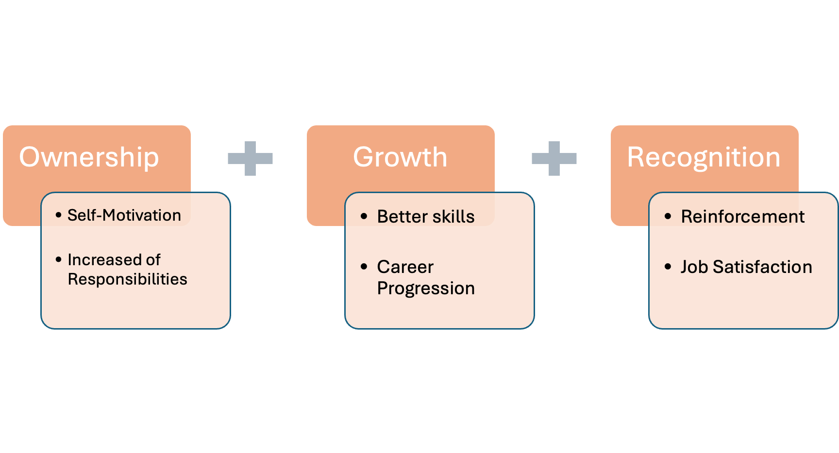
Intrinsic Motivation
SBGs to identify 2 promising breakthroughs and personally supervise the progress.
Hence inspiring, motivating the team to change and achieve the breakthroughs.

Slide 30
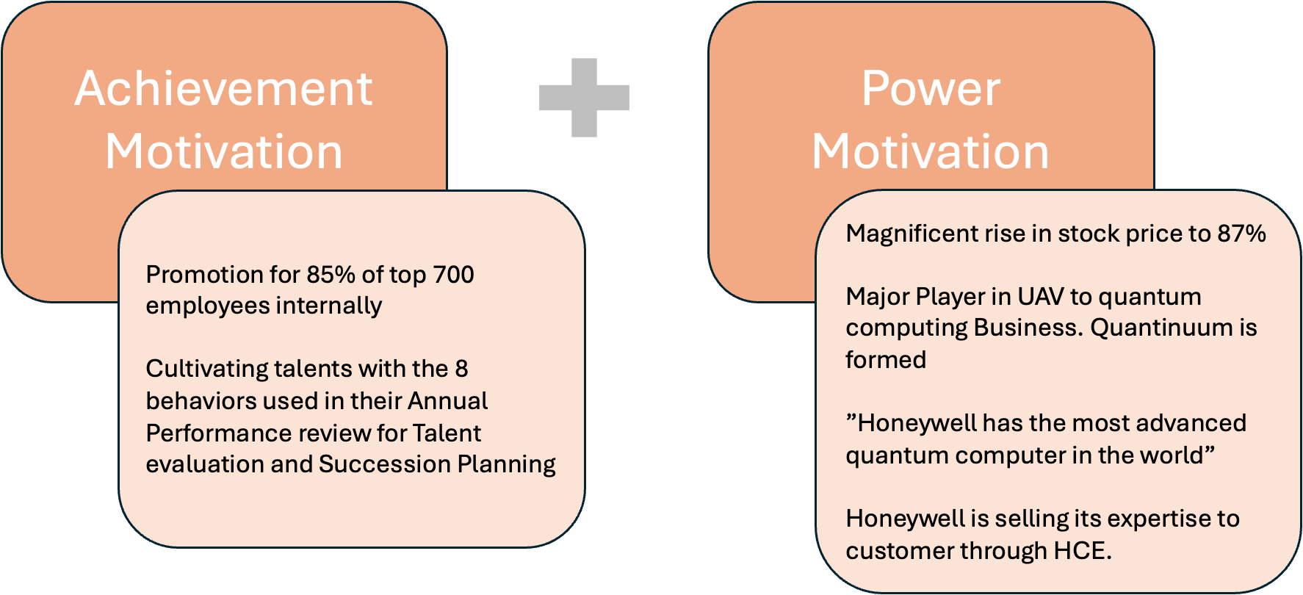
Extrinsic Motivation

Slide 31






Feedback & Adaption
Request (formal/informal)
Performance Appraisal
Direct communication
VOE and APS
Office Grapevines
Social media
Reflect
Gaining Insights
Review, consider
re-evaluate
Areas for improvement
Resolve
Recognition
For continuous & Sustain Change
Progression & Opportunities must be in place
Adaption not Adoption
Internal
Employees
External​
Customers ​ Analysts
Vendors​ Suppliers​
Receive
Active Listening
Take in 2nd opinion
Clarification
Response
Customized solution uniquely for each of their staff

Slide 32


Leadership Engagement
Leadership Communication
Leadership
Succession Planning
Leadership
Management
Transparent Communication
Via town hall and regular updates from senior executives to share company vision, strategy, and objectives.
Talent evaluation &
Succession Planning
Identify and groom high-potential leaders for future leadership positions.
Honeywell ensures continuity and stability in its leadership.
Voice of Employee (VOE)
Annual Pulse Survey (APS)
Leader and Management
Honeywell top reasons for
project successes were​​​
• Effective user involvement​​​
• Executive management support​​​
They drive change by inspiring
employees hence making
change more sustainable​
Employees want to change.

Slide 33


Leadership Engagement
Leadership on
Sustaining Change
Leadership Training
Sustaining Change
Continuously reinforce vision that led to the change to ensure it remains clear to everyone.
Acknowledge and celebrate small victories, building positive momentum among teams.
Honeywell aims to drive innovation, collaboration, and business growth across the organization.
Soft skills and Hard skills
Critical thinking and Leadership skills
New Hire Training
Job Roles re-design Training
Advanced career progression Training
Professional certifications
Cross functional Job training

Slide 34



Sustaining Change : Job Redesign
Design, implementing and maintaining technology infrastructure for process optimization at Honeywell
Infrastructure Technology Engineer
Comprehensive digital transformation initiatives, integrating advanced technologies like IoT, AI, and data analytics
Digital
Transformation
Consultant​
Responsible for Honeywell's quantum computing business which includes developing, optimizing, maintaining software applications and algorithms
Expertise with protocol for machine learning tasks, such as classification, regression, clustering, and optimization in quantum computing, machine learning, and data analysis to drive innovation and advance the field of quantum machine learning at Quantinuum.
Quantum Computing Software Engineer
Quantum Machine Learning Scientist
Monitoring economic trends and growth for Honeywell's business development planning.
Driving sustainability through initiatives like renewable energy and global greenhouse gas emissions reduction. Crafting strategic plans aligned with global economic trends for Honeywell's growth.
Development Coordinator
Economic Analyst
Innovation mindset towards developing social governance ESG technologies
Focus on addressing the most daunting sustainability challenges through innovation and investment to help Honeywell and customers meet ESG objectives. To foster design excellence and drive innovation.
Creative
Analyst​
Sustainability Innovation
Director

Slide 35
Sustaining Change: Incentives
Key Drivers
Honeywell Digital Team
Strategic Team
Supply Chain Transformation Team
Digital Transformation across SBGs
Connected
Software Solutions
(HCE)
High-Tech Automation
Enterprise Performance Management
Sustainability& ESG Outcomes
Delivery Optimization
Digital Supply chain
Data Analytics for decision making
Objectives
Bonus Type
Perks
Incentives both for Individual and Team
Monetary Incentives
Performance-Based Bonuses
Skill based pay
Profit-Sharing Program
Stock Options or Shares
Special Achievement Bonus
Non-Monetary Incentives
Recognition and Awards Programs
Health & Wellness Initiatives
Onshore Travel Benefits
Professional Development Opportunities
Education Assistance
Performance Appraisal Metrics

Slide 36
Sustaining Change: Incentives
Incentive structure to encourage desirable behaviors
Short-term versus Long-term
Sales Incentives
Technology Co-Innovation Fund
Innovation Fund Bank for New Ideas.
Free external certifications for unique Ideas using niche Technology
Highest sales Award
Most popular product
Sales Commission
Incentive 1
Incentive 4
Short-term
On the spot Awards
Long-Term
Incentive 5
Retirement Pension Plans
Life & Disability Insurance
Additional Voluntary Benefits for Tax Saving
Cost of Living Assistance
Honeywell Gems Award
X years of service Award
Hackathon Award
Incentive 2
Flexible Benefit Plans
Transportation Facilities
House Rent Benefits according to the organization structure
Paid Time Off
Incentive 6
Leadership Opportunities
Global Leadership Exposure
R&D Leadership
Executive Role Position
Incentive 3

Slide 37
Sustaining Change : Cultures
Diversity
Beliefs
Values
Norms
Belonging
Honeywell need to post strong financials with a culture that actively incubated innovative breakthrough technologies within SBGs.

Slide 38
Sustaining Change : Behaviors
Existing and Desirable Behaviors as part of KPI
Have a passion for winning
Team Collaboration
Willingness to share resources when needed
Be a Zealot for growth
Forward Looking
Proactively anticipating and preparing for the future
Think Big then make it happen
Solution -Oriented
Geared towards solving problems and finding constructive solutions
Act with Urgency
Take Ownerships
Assume Responsibility & Accountability
Be Courageous
Become your Best
Be Committed
Build Exceptional Talent
Existing
New Desirable

Slide 39

Sustaining Change : Recruitment
Job Role | Data Scientist | DevSecOps Engineer
Main Function | Analyzing complex datasets to extract valuable insights. Developing predictive models and algorithms. Collaborating with cross-functional teams to address business challenges | Integrating security practices into the DevOps pipeline. Automating security processes to enhance efficiency. Collaborating with development and operations teams for secure software delivery.
Job Description | Utilize statistical and machine learning techniques for data analysis. Interpret and communicate findings to non-technical stakeholders. Stay updated on industry trends and emerging technologies | Implement security measures in software development and deployment. Conduct security assessments and vulnerability testing. Collaborate on creating secure CI/CD pipelines
Competencies Required | Proficiency in programming languages (Python, R). Strong statistical and analytical skills. Effective communication and collaboration abilities | Knowledge of DevOps practices. Familiarity with security frameworks and protocols. Automation and scripting skills

Slide 40



Sustaining Change : Recruitment
Job Role | Cloud Engineer | Artificial Intelligence Specialist
Main Function | Designing, implementing, and managing cloud infrastructure. Ensuring scalability, security, and reliability of cloud-based applications. Collaborating with development teams for optimal cloud utilization. | Developing and implementing AI solutions. Collaborating on AI strategy and innovation. Keeping abreast of AI advancements and industry trends
Job Description | Deploying and managing cloud environments (AWS, Azure, or Google Cloud). Optimizing cloud infrastructure for cost and performance. Troubleshooting and resolving cloud-related issues. | Designing and training machine learning models. Integrating AI into existing systems and processes. Collaborating with cross-functional teams for AI-driven projects
Competencies Required | Cloud platform expertise. Infrastructure as Code (IaC) knowledge. Problem-solving and troubleshooting skills. | Proficiency in machine learning frameworks, Problem-solving and critical-thinking skills Strong knowledge of AI principles and applications

Slide 41
Competitive salary for new Job Roles ,retaining the old ones can be done with below parameters
Sustaining Change : Compensation
Role Evaluation
Benchmarking
Acquired Skillset
Market Trends Alignment
Retention Strategies
Flexible Packages
Honeywell sustained growth and innovation can take place with pivotal role of technology and the need for exceptional talent to sustain change.

Slide 42
Sustaining Change-Immediate Usage
Clear Communication
Honeywell can start using the solutions by communicating transparently with Team
Leadership Involvement
Honeywell Leaders can champion the change, emphasizing its importance and aligning it with the company's long-term vision and goals.
Assessment of current state
Honeywell can start focusing on Job Re-design, Recruitment, Enhanced Incentive Structure and Performance Appraisal
Can Honeywell use these solution immediately to facilitate change?
Job Re-design / Recruitment
(Can HoneyWell implement immediately? Yes.)
Intrinsic Extrinsic Motivation Plan
(Can HoneyWell use these motivation plan immediately? Yes.)
Incentives from Performance Appraisal
(Can HoneyWell implement? Yes.)

Slide 43


Join the transformation journey now, make a difference today.
Embrace change for a successful future in your organization.

